Slide 1
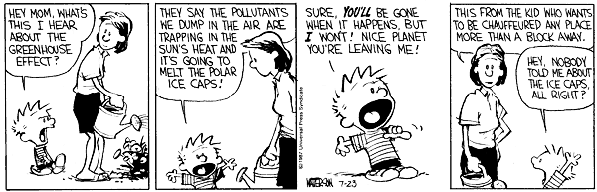
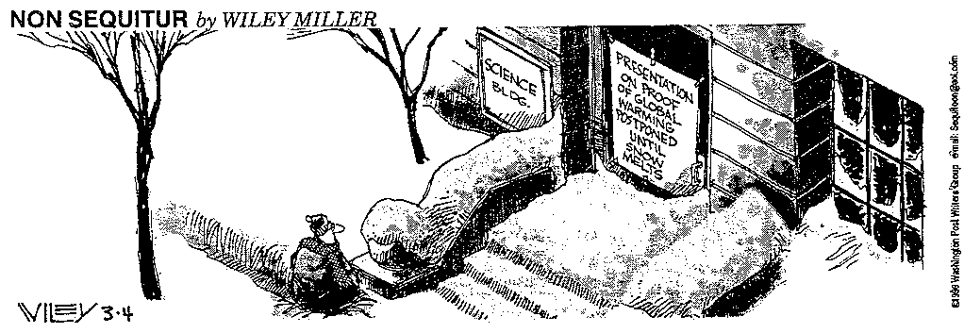
Notes:
We want to believe it but do not do anything…

Slide 2
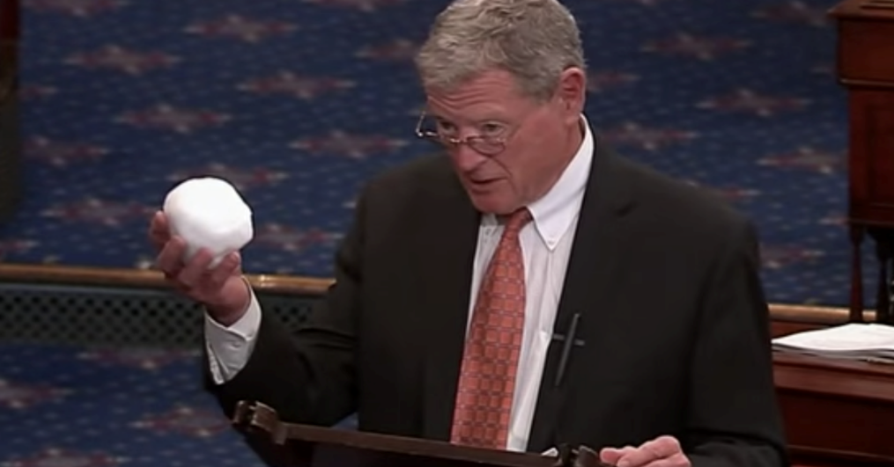
Jim Inhofe -quotes
"C0₂ does not cause catastrophic disasters-actually it would be beneficial to our environment and our economy."
"It's also important to question whether global warming is even a problem for human existence. Thus far no one has seriously demonstrated any scientific proof that increased global temperatures would lead to the catastrophes predicted by alarmists. In fact, it appears that just the opposite is true: that increases in global temperatures may have a beneficial effect on how we live our lives. ”
"this 97% [of climate scientists accepting human-caused global warming], that doesn't mean anything. I named literally thousands of scientists on the floor...and these were top people."

Slide 3

The Intergovernmental Panel on Climate Change (IPCC) is the international body for assessing the science related to climate change. The IPCC was set up in 1988 by the World Meteorological Organization (WMO) and United Nations Environment Programme (UNEP) to provide policymakers with regular assessments of the scientific basis of climate change, its impacts and future risks, and options for adaptation and mitigation.
IPCC assessments are written by hundreds of leading scientists who volunteer their time and expertise as Coordinating Lead Authors and Lead Authors of the reports. They enlist hundreds of other experts as Contributing Authors to provide complementary expertise in specific areas.
http://www.ipcc.ch/news_and_events/docs/factsheets/FS_what_ipcc.pdf

Slide 4
Intergovernmental Panel on Climate Change
“... the observed increase could be largely due to this natural variability; alternatively this variability and other human factors could have offset a still larger human-induced greenhouse warming.” —IPCC First Assessment Report, 1990
“The balance of evidence suggests a discernible human influence on global climate.” —IPCC Second Assessment Report, 1995
“There is new and stronger evidence that most of the warming over the last 50 years is attributable to human activities.” —IPCC Third Assessment Report, 2001
“with 90% certainty, that human activities, especially the burning of fossil fuels, have caused global warming during the past 50 years. – IPCC Fourth Assessment Report”, 2007

Slide 5
IPCC Fifth Assessment Report, 2014
Anthropogenic greenhouse gas emissions have increased since the pre-industrial era driven largely by economic and population growth. From 2000 to 2010 emissions were the highest in history. Historical emissions have driven atmospheric concentrations of carbon dioxide, methane and nitrous oxide to levels that are unprecedented in at least the last 800,000 years, leading to an uptake of energy by the climate system.
The evidence for human influence on the climate system has grown since AR4. Human influence has been detected in warming of the atmosphere and the ocean, in changes in the global water cycle, in reductions in snow and ice, and in global mean sea level rise; and it is extremely likely to have been the dominant cause of the observed warming since the mid20th century. In recent decades, changes in climate have caused impacts on natural and human systems on all continents and across the oceans. Impacts are due to observed climate change, irrespective of its cause, indicating the sensitivity of natural and human systems to changing climate.

Slide 6
Of the 489 Earth and atmospheric scientists surveyed by Harris Interactive, 97 percent said that global temperatures have increased during the past 100 years, and 74 percent agreed that "currently available scientific evidence substantiates the occurrence of human-induced greenhouse warming."
The scientists were about evenly divided on whether they thought the effects of global climate change over the next 50 to 100 years were likely to be near catastrophic (41 percent) or moderately dangerous (44 percent). About 13 percent saw relatively little danger. About 56 percent of the scientists said that global climate change was a mature science, while 39 percent termed it an emerging science.
Survey Tracks Scientists' Growing Climate Concern
US News and World Report
Marianne Lavelle
April 23, 2008

Slide 7
97% of the climatologists agreed that human activity has been a significant factor in changing mean global temperatures, while that figure was only 64% for meteorologists and 47% for the petroleum geologists.
Peter Doran, University of Chicago Survey

Slide 8
Global Climate Change –
What are the Trends?
https://www.ncdc.noaa.gov/temp-and-precip/global-maps/
NOAA National Centers for Environmental information, Climate at a Glance: U.S. Time Series, published August 2016, retrieved on August 13, 2016 from https://www.ncdc.noaa.gov/temp-and-precip/national-temperature-index/

Slide 9
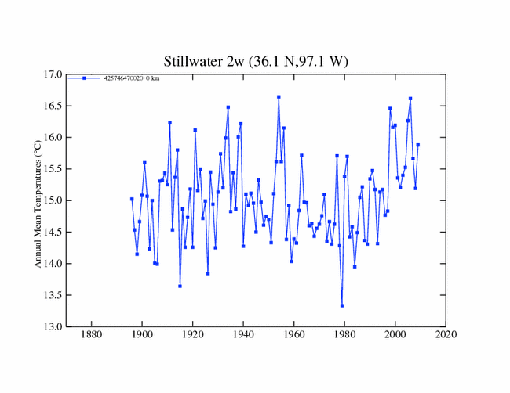

Slide 10
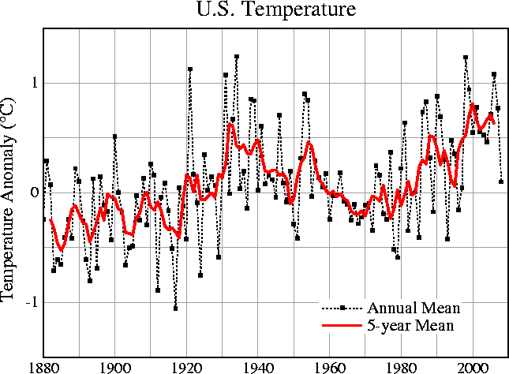

Slide 11
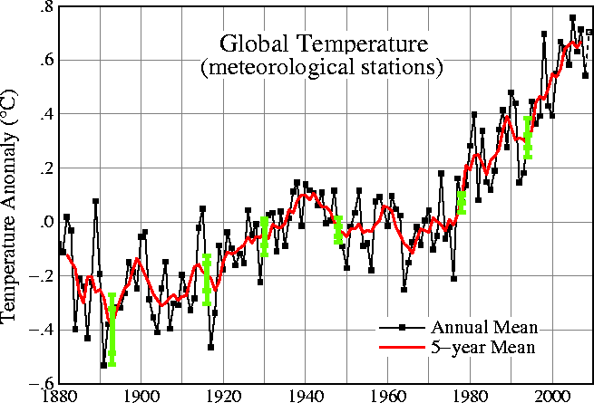
Source: OSTP
Notes:
Global Average Temperature Is Increasing
This steady increase of CO₂ in the atmosphere has caused greater retention of heat and a gradual warming of the earth: global average surface temperature has risen by about 1°F over the last century.
The 13 warmest years this century have all occurred since 1980, with 1998 the warmest on record.
The term global warming is used to describe the enhanced greenhouse effect resulting from human activities.

Slide 12
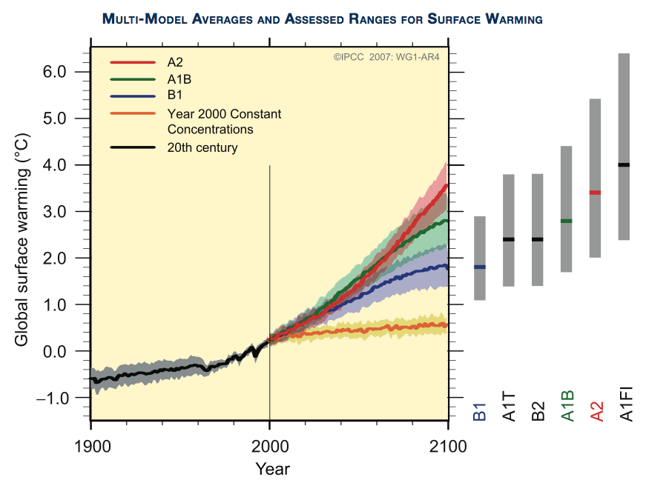
Models
IPCC 2007
Notes:
After the vote, some leading climate-change scientists took issue with Luetkemeyer's assertions and said that de-funding the IPCC would hurt international efforts to study and analyze climate change. The IPCC does not conduct its own research, but assesses the most recent worldwide scientific, technical and socio-economic information on the issue.
Christopher Field, a co-chair of an IPCC working group who is director of the Carnegie Institution's Department of Global Ecology, told the Beacon on Monday that the IPCC "is a very good deal for the governments and for the world." Field, a leading U.S. climate change researcher, is also a professor of biology and environmental earth system science at Stanford University in Palo Alto, Calif.
"The IPCC has been able to harness, at a minimal cost, a remarkable pool of scientific knowledge and experience through this approach of engaging volunteers," said Field, who spoke at Washington University in St. Louis last September. "In their work with the IPCC, hundreds of the world's leading scientists are donating their nights and weekends to provide the world's governments with the best available information on climate science."
fter the vote, some leading climate-change scientists took issue with Luetkemeyer's assertions and said that de-funding the IPCC would hurt international efforts to study and analyze climate change. The IPCC does not conduct its own research, but assesses the most recent worldwide scientific, technical and socio-economic information on the issue.
Christopher Field, a co-chair of an IPCC working group who is director of the Carnegie Institution's Department of Global Ecology, told the Beacon on Monday that the IPCC "is a very good deal for the governments and for the world." Field, a leading U.S. climate change researcher, is also a professor of biology and environmental earth system science at Stanford University in Palo Alto, Calif.
"The IPCC has been able to harness, at a minimal cost, a remarkable pool of scientific knowledge and experience through this approach of engaging volunteers," said Field, who spoke at Washington University in St. Louis last September. "In their work with the IPCC, hundreds of the world's leading scientists are donating their nights and weekends to provide the world's governments with the best available information on climate science."
What is the problem – even some of these we know are off; gores CO2 prediction has since been deemed to be off…but with that said, we can see current trends, now that it is increasing; putting that cap as to where it goes is important!

Slide 13
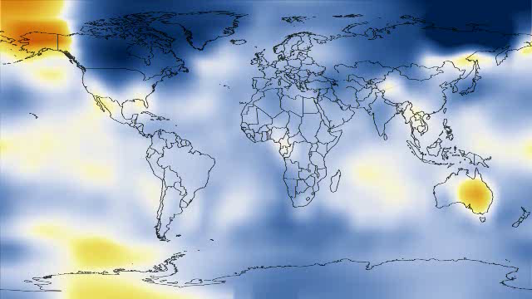


Slide 14
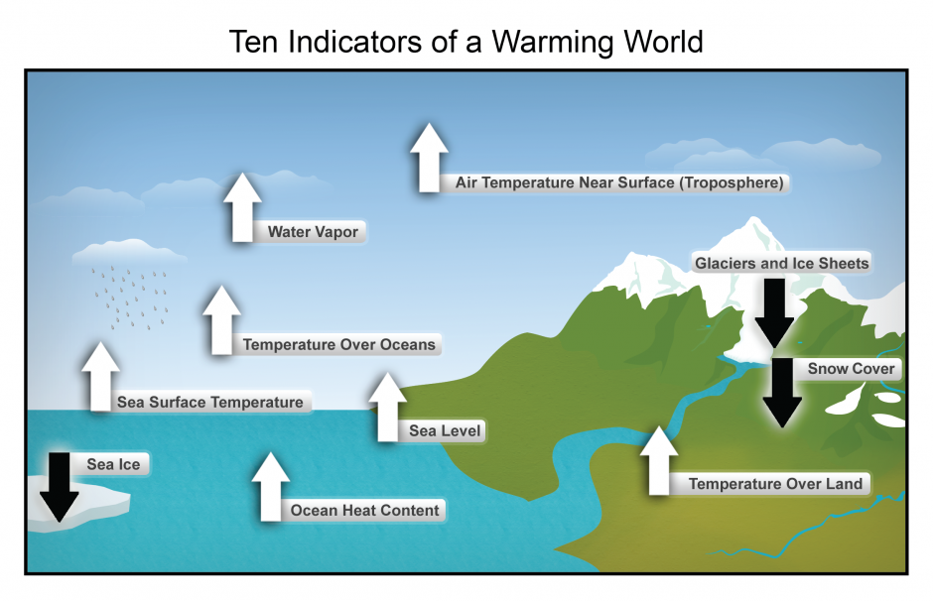
https://www.ncdc.noaa.gov/climate-information/climate-change-and-variability

Slide 15
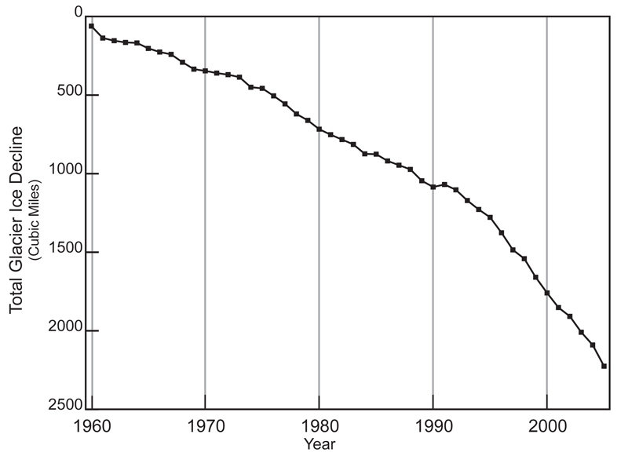
Other Changes
Notes:
Warming temperatures lead to the melting of glaciers and ice sheets. The total volume of glaciers on Earth is declining sharply. Glaciers have been retreating worldwide for at least the last century; the rate of retreat has increased in the past decade. Only a few glaciers are actually advancing (in locations that were well below freezing, and where increased precipitation has outpaced melting). The progressive disappearance of glaciers has implications not only for a rising global sea level, but also for water supplies in certain regions of Asia and South America.

Slide 16
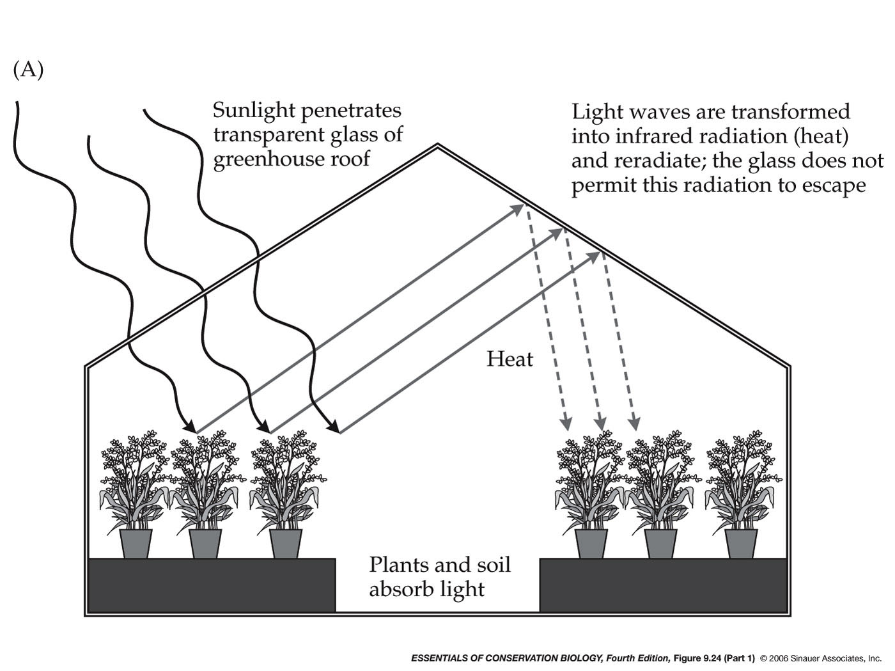
Global Climate Change: How does a Greenhouse Work?
Notes:
Place to start is with a green house. What happens as sunlight hits the roof of a green house?
Hits the ground and changes into infrared radiation (heat) and it is reradiated (sent back up into the atmosphere. In a greenhouse, though it is not allowed to leave. It traps the heat in the green house causing it to warm.

Slide 17
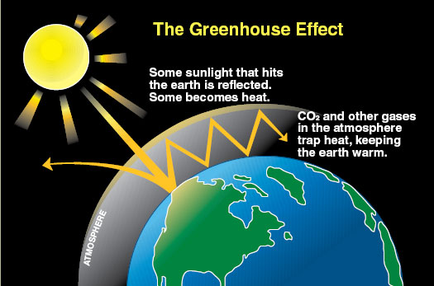

Slide 18
What is the greenhouse effect?
21% reflected from clouds
5% reflected from dust in atmosphere
1-2% absorbed by plants
6% reflected from water, soil, air, vegetation
67% converted to heat

Slide 19
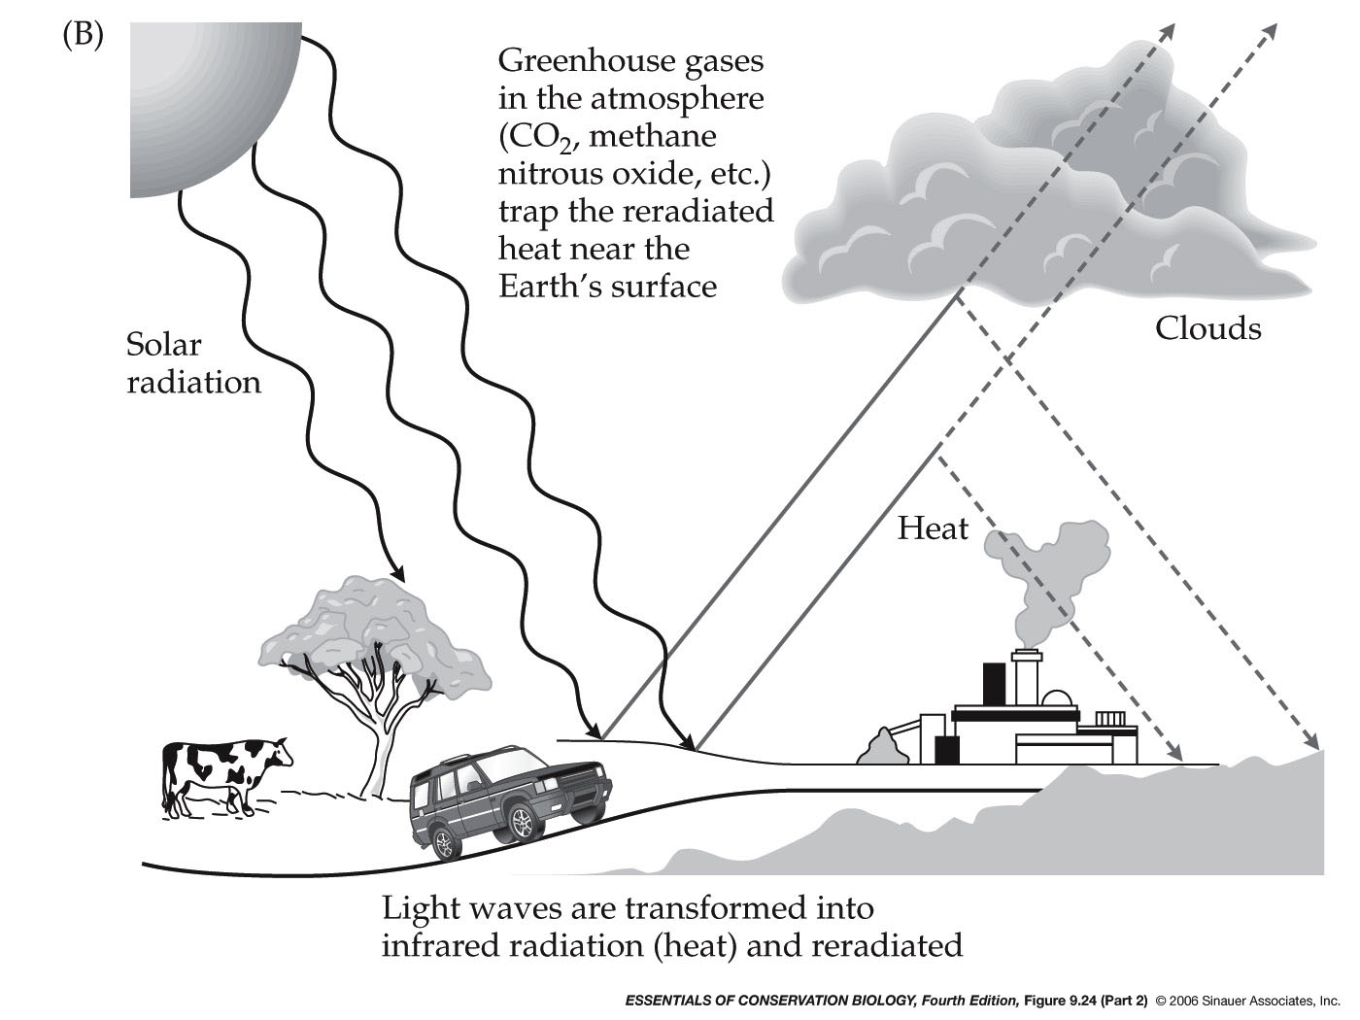
Global Climate Change – Greenhouse Effect
Notes:
Solar radiation passes through the atmosphere as UV waves
When UV waves hits earth’s surface, they are transformed into infrared (IR) waves (heat)
IR can not penetrate “Greenhouse Gases” these gases act as the roof of a greenhouse. They trap the heat….
Heat is “trapped”
Earth would be much colder without it (up to 33%!). So this is a good thing…we would be in trouble without it. The problem is today that we have altered this cycle through human activities – concentrations of greenhouse gases are increasing that most scientists believe that it is already affecting the earth’s climate…global climate change…

Slide 20
Global Climate Change
Greenhouse Gases
  Water vapor
  Carbon dioxide
  Methane
  Nitrous oxide
  Chlorofluorocarbons (CFCs) (Anthropogenic)
Notes:
Greenhouse gases = these function much like a green house
Again, these are present in the environment naturally…but what are they?
of human activities are:
Carbon Dioxide (CO2): Carbon dioxide enters the atmosphere through the burning of fossil fuels (oil, natural gas, and coal), solid waste, trees and wood products, and also as a result of other chemical reactions (e.g., manufacture of cement). Carbon dioxide is also removed from the atmosphere (or “sequestered”) when it is absorbed by plants as part of the biological carbon cycle.
Methane (CH4): Methane is emitted during the production and transport of coal, natural gas, and oil. Methane emissions also result from livestock and other agricultural practices and by the decay of organic waste in municipal solid waste landfills.
Nitrous Oxide (N2O): Nitrous oxide is emitted during agricultural and industrial activities, as well as during combustion of fossil fuels and solid waste.
Fluorinated Gases: Hydrofluorocarbons, perfluorocarbons, and sulfur hexafluoride are synthetic, powerful greenhouse gases that are emitted from a variety of industrial processes. Fluorinated gases are sometimes used as substitutes for ozone-depleting substances (i.e., CFCs, HCFCs, and halons). These gases are typically emitted in smaller quantities, but because they are potent greenhouse gases, they are sometimes referred to as High Global Warming Potential gases (“High GWP gases”).
Co2 – fossil fuels – 50%
CFC – refrigerants, solvents, foams, aerosols, propellants – 20%
Methane – Rice paddies, swamps, bogs, cows - 16
Nitrous oxide – fossil fuels, fertilizers, soils, burning of wood and crop residue 6

Slide 21
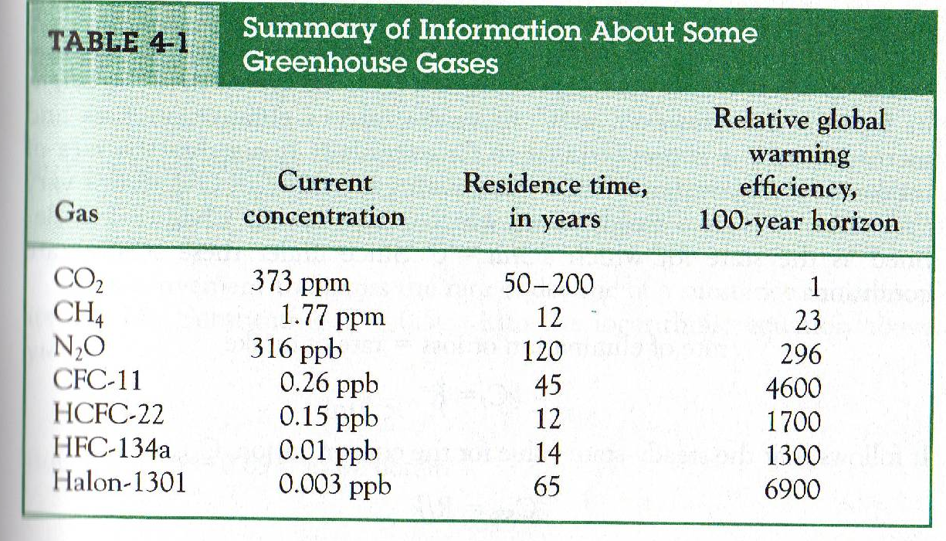

Slide 22
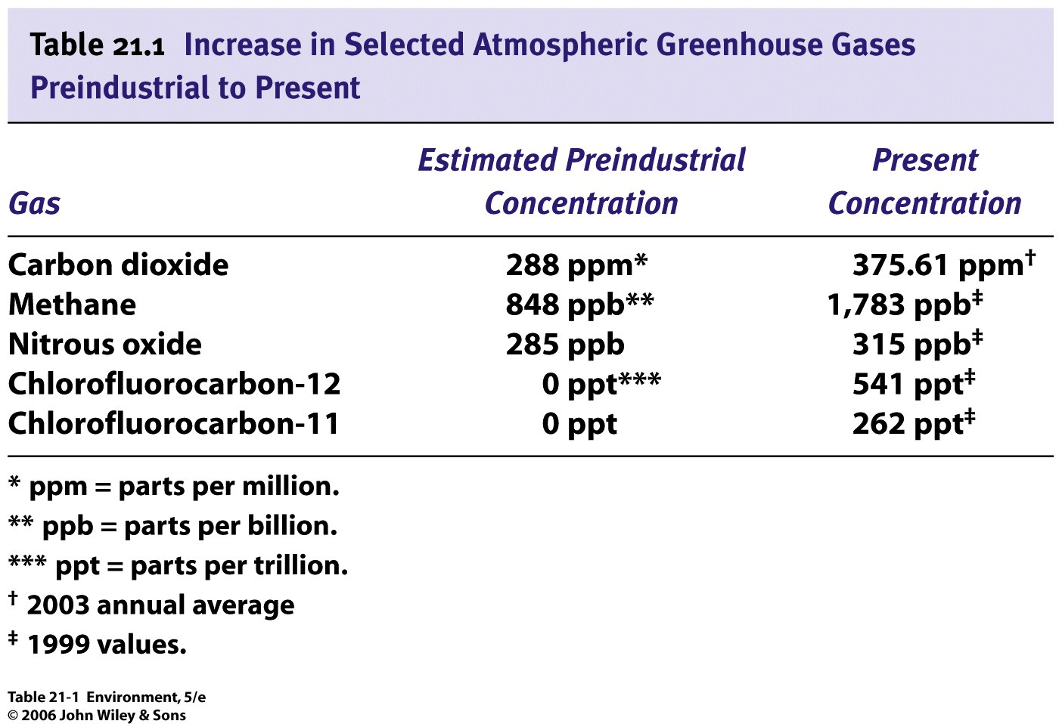

Slide 23
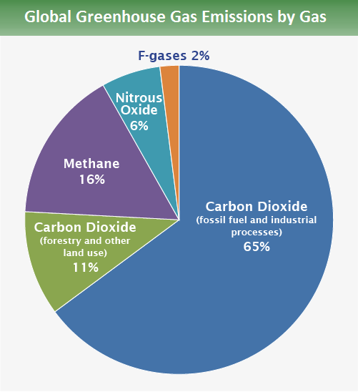
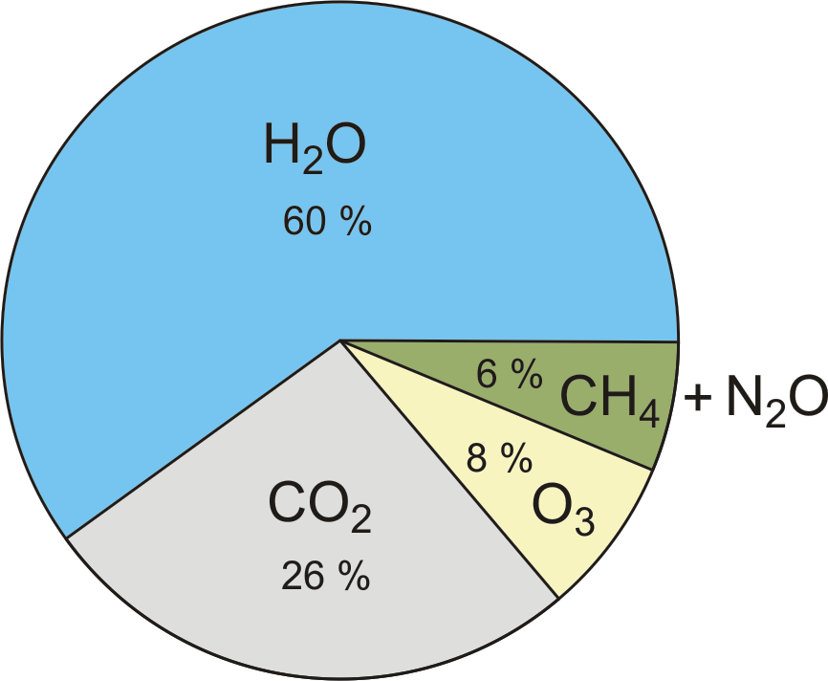
https://www.epa.gov/ghgemissions/global-greenhouse-gas-emissions-data

Slide 24
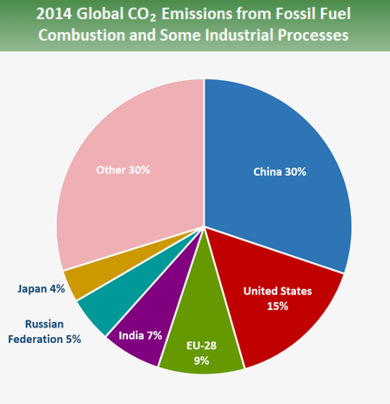
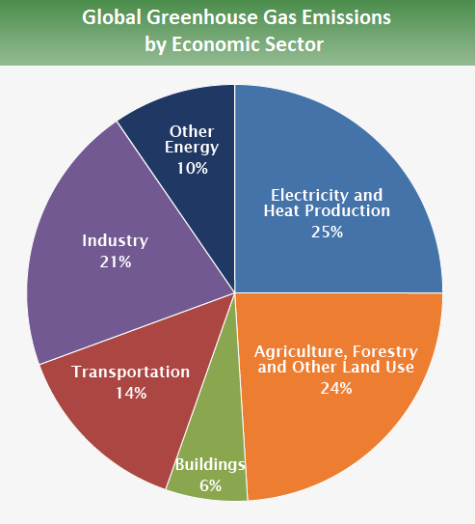
https://www.epa.gov/ghgemissions/global-greenhouse-gas-emissions-data

Slide 25
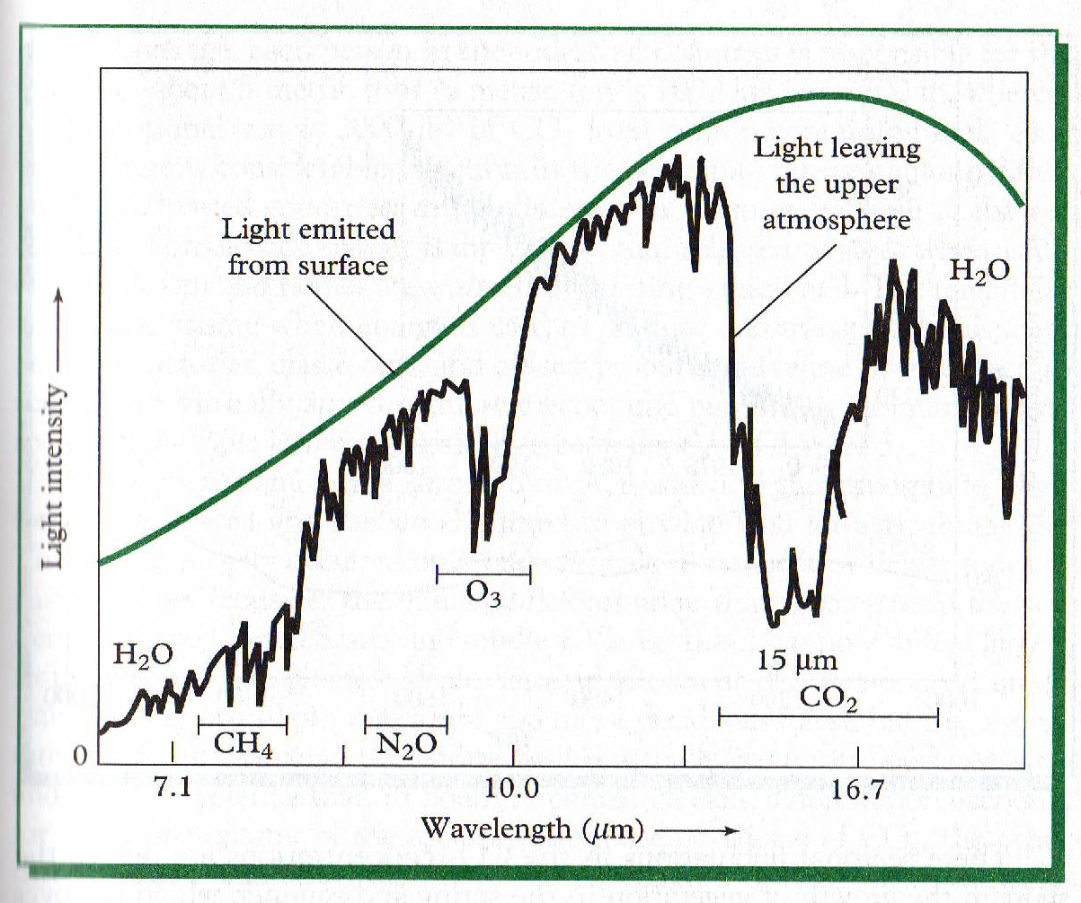

Slide 26
Greenhouse Gases are Increasing in the Atmosphere
Carbon dioxide = most abundant of the greenhouse gases
  Levels increasing
  Largely due to increasing use of fossil fuels
Stays in the atmosphere for long periods of time
Projected to double by the end of the century***
Notes:
Stays in the atmosphere for long periods of time
E.g. persistent!
Combine this with deforestation….

Slide 27
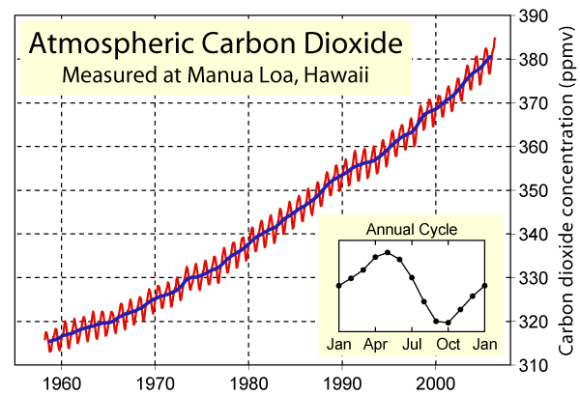

Slide 28
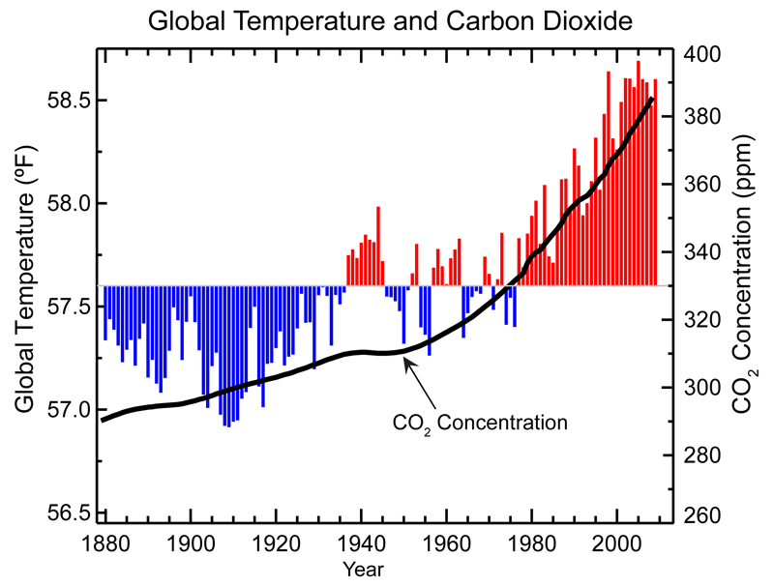
What is the Relationship between CO2 and Temperature?
Notes:
Global average temperature is one of the most-cited indicators of global climate change, and shows an increase of approximately 1.4°F since the early 20th Century. The global surface temperature is based on air temperature data over land and sea-surface temperatures observed from ships, buoys and satellites. There is a clear long-term global warming trend, while each individual year does not always show a temperature increase relative to the previous year, and some years show greater changes than others. These year-to-year fluctuations in temperature are due to natural processes, such as the effects of El Ninos, La Ninas, and the eruption of large volcanoes. Notably, the 20 warmest years have all occurred since 1981, and the 10 warmest have all occurred in the past 12 years.
Global annual average temperature measured over land and oceans. Red bars indicate temperatures above and blue bars indicate temperatures below the 1901-2000 average temperature. The black line shows atmospheric carbon dioxide concentration in parts per million.
Thousands of land and ocean temperature measurements are recorded each day around the globe. This includes measurements from climate reference stations, weather stations, ships, buoys and autonomous gliders in the oceans. These surface measurements are also supplemented with satellite measurements. These measurements are processed, examined for random and systematic errors, and then finally combined to produce a time series of global average temperature change. A number of agencies around the world have produced datasets of global-scale changes in surface temperature using different techniques to process the data and remove measurement errors that could lead to false interpretations of temperature trends. The warming trend that is apparent in all of the independent methods of calculating global temperature change is also confirmed by other independent observations, such as the melting of mountain glaciers on every continent, reductions in the extent of snow cover, earlier blooming of plants in spring, a shorter ice season on lakes and rivers, ocean heat content, reduced arctic sea ice, and rising sea levels.

Slide 29
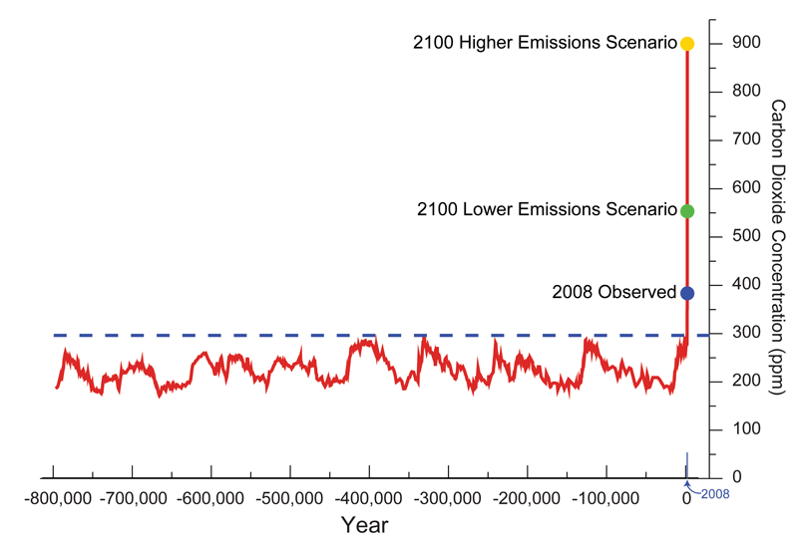
Long term CO2 Trends
Notes:
Talk about models – uncertainty

Slide 30
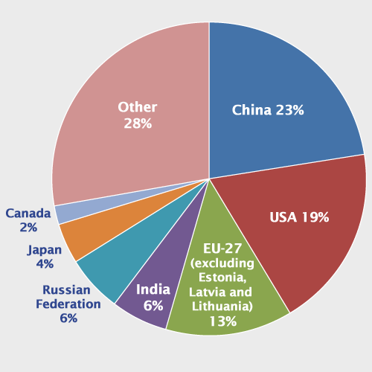
CO2 emissions
Notes:
In 2008, the top carbon dioxide (CO₂) emitters were China, the United States, the European Union, India, the Russian Federation, Japan, and Canada. These data include CO₂ emissions from fossil fuel combustion, as well as cement manufacturing and gas flaring. Together, these sources represent a large proportion of total global CO₂ emissions.
Emissions and sinks related to changes in land use are not included in these estimates. However, changes in land use can be important - global estimates indicate that deforestation can account for 5 billion metric tons of CO₂ emissions, or about 16% of emissions from fossil fuel sources. Tropical deforestation in Africa, Asia, and South America are thought to be the largest contributors to emissions from land-use change globally. ^{[3]} In areas such as the United States and Europe, changes in land use associated with human activities have the net effect of absorbing CO₂, partially offsetting the emissions from deforestation in other regions.

Slide 31
Carbon Sources vs. Sinks
Source = processes that contribute CO2 to the atmosphere
Sinks = processes that remove CO2 from the atmosphere
Important implications for global management of CO2 and warming
Notes:
So if we remove trees which are a sink of CO2, we can not control increases. However, trees can help to reduce levels.
Deforestation
fewer plants are available to remove CO₂
Net effect is an additional 5 billion tons of carbon dioxide per year
Trees take it up! Sink = therefore, plants are a good thing…look at deforestation! Remove trees, reducing natural ability to remove or deal with CO2
All things equal – not producing more, than, still having effect because of what we are doing to forests!
One paper we have!

Slide 32
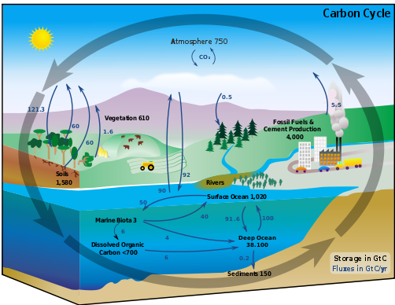

Slide 33
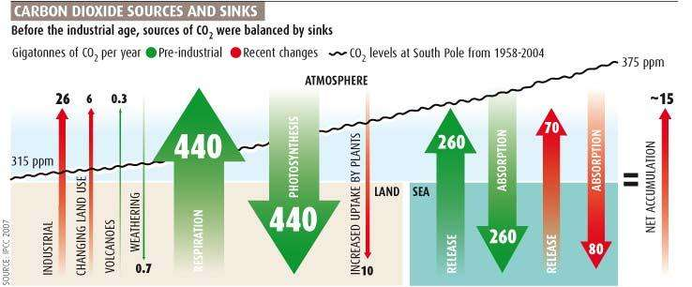

Slide 34
Methane
More efficient at absorbing heat than CO2
Less persistent in the environment
Changes in agricultural practices and pollution control
Notes:
More efficient = therefore do not need as much in the environment… they also persist for long periods of time.
Change in agricultural practices – we have a lot of cows today!

Slide 35
Sources of Methane
Anaerobic digestion
Wetlands produce “Swamp gas” i.e. methane
So new wetlands (hydro dams, rice paddies) contribute CH₄ (but presumably, drained wetlands produce less!)
Net increase in ruminants.
Fossil fuels.
CH₄ accumulation accelerated after WWII, but is now decreasing.

Slide 36
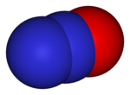
Nitrous Oxide N₂O
296 x more potent than CO₂, per molecule
Accumulating since ~300 years ago
Eventually rises to stratosphere where it decomposes to N2 + O

Slide 37
Sources of N₂O
Main sources from the N cycle:
  Denitrification, NO₃- → N₂
  Nitrification, NH₄ → NO₃
  Our acceleration of the N cycle likely the largest anthropogenic contribution
Burning Biomass or coal (which have fuel N)
Regular combustion and NO can eventually produce N₂O through catalytic converters

Slide 38
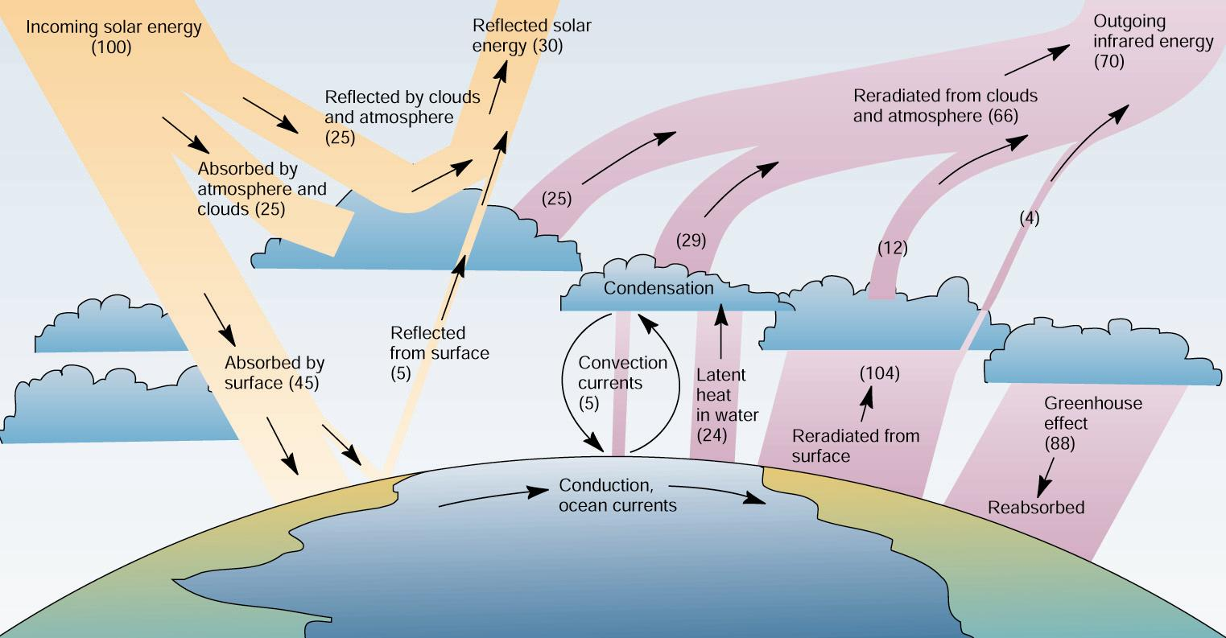
Solar Influx and balance
Make a list of 6 factors that need to be considered for climate change. Indicate if heating or cooling will occur.

Slide 39
Soot and carbon black
In the atmosphere, its black surface does absorb light, and so heats up—increased atmospheric warming
But it shades the ground—decreased local temperatures!

Slide 40
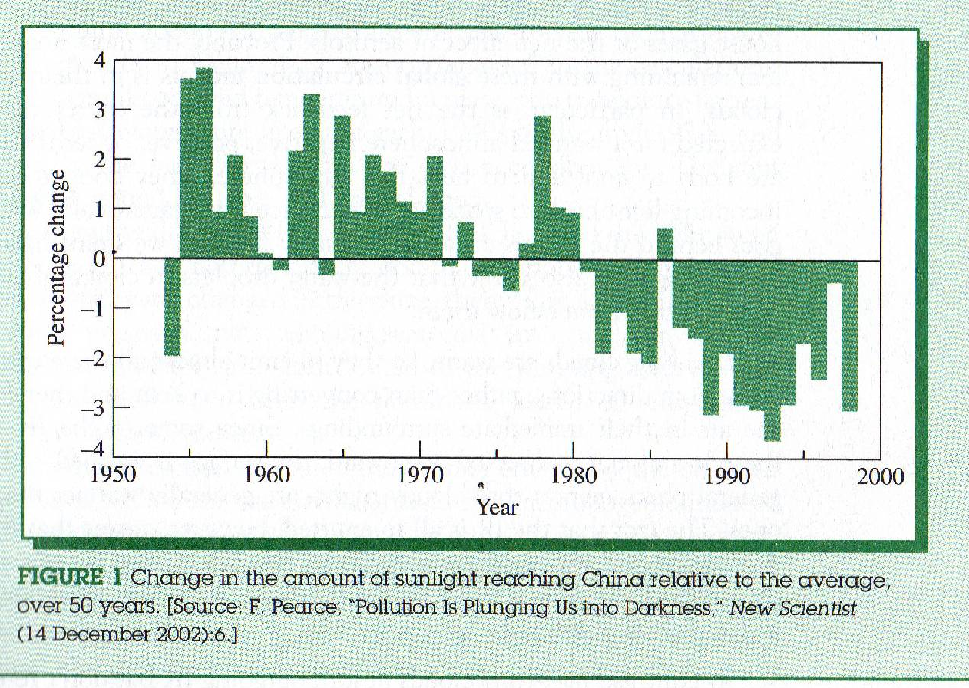
Notes:
China where industrial pollution is high…

Slide 41
Atmospheric cooling
Some emissions and atmospheric effects also cool the earth.

Slide 42
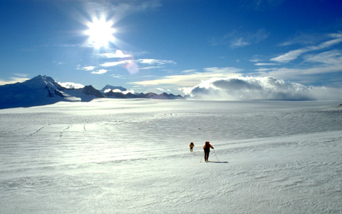
  Albedo - Reflectivity
    Fresh clean snow reflected. 90%
    Water (low sun) 50 – 80%
    Water (sun overhead) 5%
    Forest 5 – 10%
    Dark soil 3%
    Net average of earth 30%

Slide 43
Sulfate aerosols
Highly reflective of incoming light—raise world’s albedo
Water, H₂SO₄, Ammonium salts do not absorb light
Removed by rain, so relatively short residence time
Ratio of SO₂ to CO₂ emissions has dropped from 2.2% pre WWII to 1.1 % --switch from coal to oil an gas

Slide 44
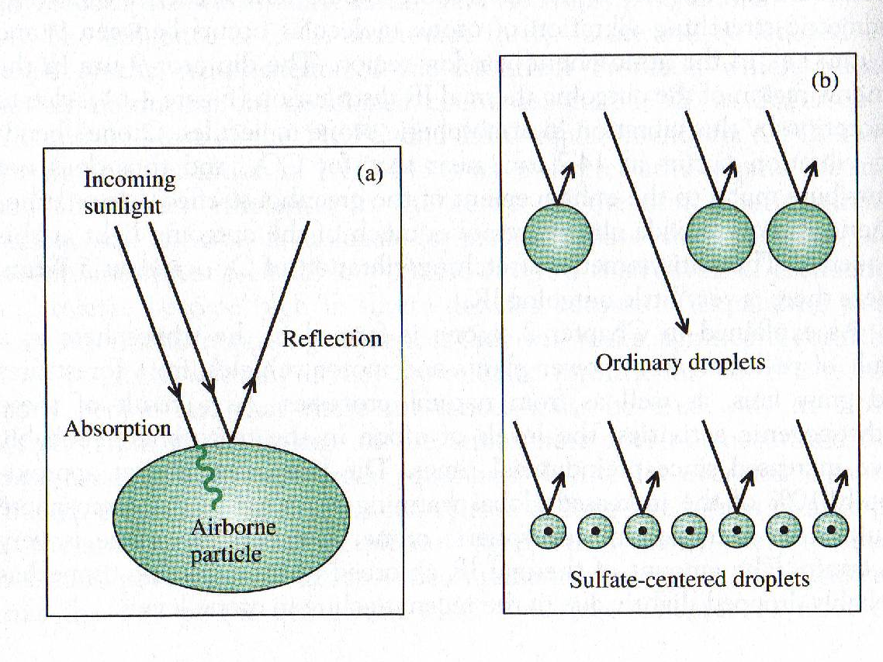

Slide 45
Feedback loops
Positive feedback loop
Negative feedback loop
+’ve input
+
+’ve output
(Destabilization)
+’ve feedback
+’ve input
-
-’ve output
(Stablization)
-’ve feedback
Notes:
What do we mean by positive?
A system exhibiting positive feedback, in response to perturbation, acts to increase the magnitude of the perturbation. That is, "A produces more of B which in turn produces more of A".^{[1]} In contrast, a system that responds to a perturbation in a way that reduces its effect is said to exhibit negative feedback. These concepts were first recognized as broadly applicable by Norbert Wiener in his 1948 work on cybernetics.[
Negative feedback occurs when the output of a system acts to oppose changes to the input of the system, with the result that the changes are attenuated. If the overall feedback of the system is negative, then the system will tend to be stable.
In a negative feedback loop, output acts as input that moves the system in the opposite direction.
This compensation stabilizes the system
Might be opposite of what you think…negative, actually A leads to b which decreases A!!!!

Slide 46
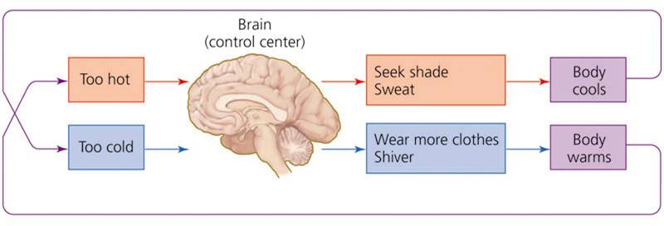
Feedback loops: Negative feedback
In a negative feedback loop, output acts as input that moves the system in the opposite direction.
This compensation stabilizes the system
Figure 6.1a

Slide 47
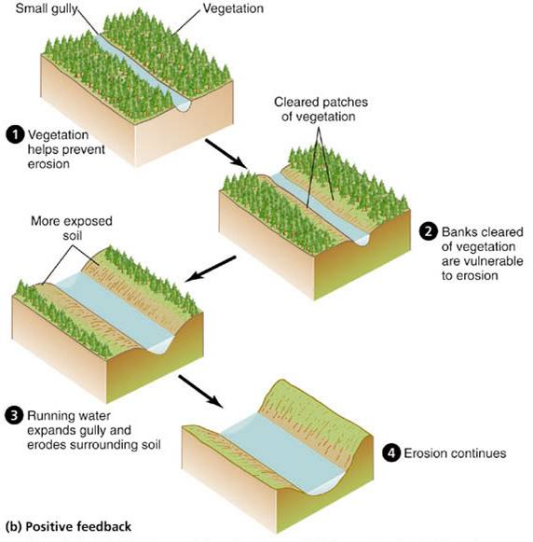
Feedback loops: Positive feedback
Figure 6.1b
Notes:
In a positive feedback loop, output acts as input that moves the system further in the same direction.
This magnification of effects destabilizes the system.

Slide 48
List 3 potential positive and negative feedback loops related to global warming.

Slide 49
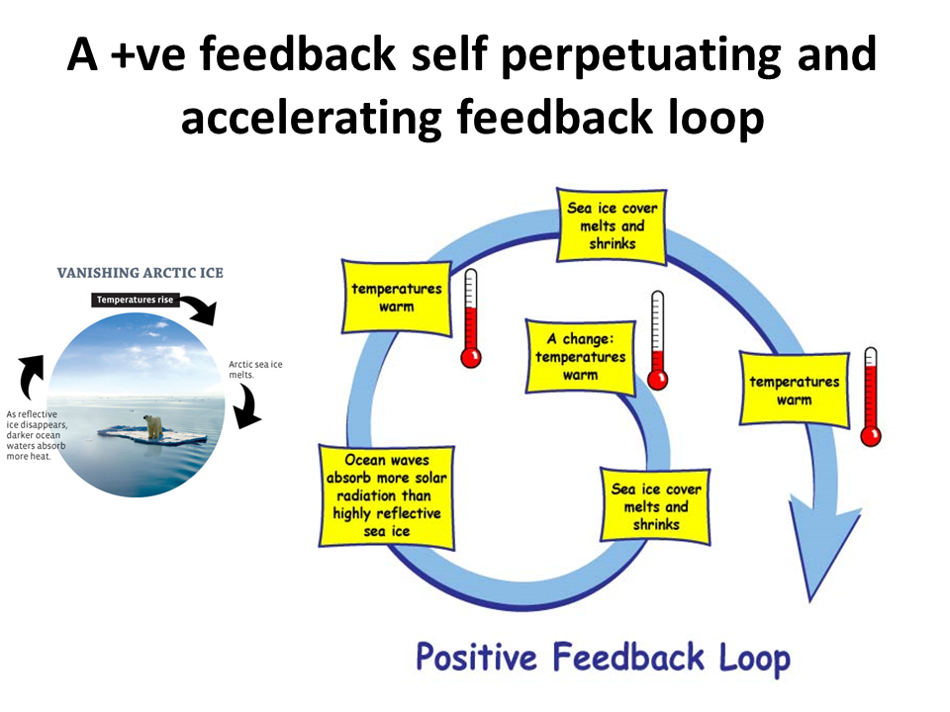

Slide 50
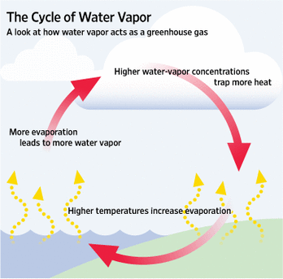

Slide 51
Positive Feedback Loops
Ocean warming → decreasing CO₂ solubility
Glacial melting → less reflection of radiation
Less snow → less reflection of radiation
Thawing of permafrost → more CO₂, CH₄
Increased demand for AC → more energy demand
Notes:
Warmer water holds less Co2 – get more co2 = more global warmin
Warming (A) – more CO2 (B) available = more global warming!

Slide 52
Negative Feedback Loops
Warmer oceans → more algae growth, uses CO₂
Increased terrestrial vegetation→ uses CO₂
Decreased heating demand → less fuel burning
More aerosols → more reflection
Notes:
Lead to reductions in global warming…

